Slide 1


English Premier League Prediction Engine
Internal Supervisor:
Dr. Sean Mondesire
Assistant Professor
Program Director
St. Thomas University

Slide 2
Group members
Armando Zapata
Camilo Riviere
Bharath Malladi

Slide 3
CONTENTS
Problem statement
Data collection
Design and implementation
Dependent variables
Independent variables
Model
Analysis
Result
References

Slide 4
PROJECT GOALS
Statement :
Create a model to predict soccer matches for the English Premier League (EPL) combining a linear regression model with machine learning.

Slide 5
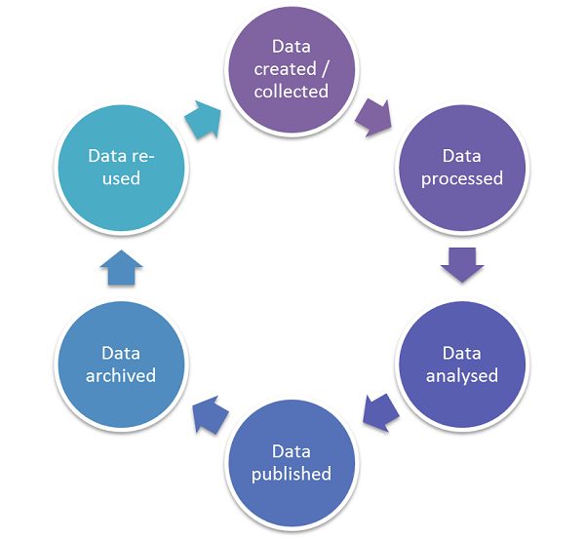
Data life cycle:

Slide 6
Design and implementation
Data mining approach for predicting the score.
Machine learning approach is used for to get the result with good accuracy.
In data mining techniques: Regression model
Machine leaning techniques: evolution computing
Design implementation: computer language R studio 1.1.463

Slide 7
Major constraints
Incorporate the data from each team and map out the desired output.
Identify the right variables that increases the model’s accuracy.
The 3-week project also posed a limit in the team’s ability to explore other variables.

Slide 8
Independent variables
Home team goals/team.
Away team goals/team.
Total home shots and total away shots.
Total shots and shots on target, shooting accuracy .
Total goals for the season.
Goals conceded and in every match.
Total passes/passes matches.
Shorts on target/shooting accuracy.
Goals conceded/goals conceded/match.

Slide 9
Dependent Variables
Match outcome.
(win, lose, or draw, and result)

Slide 10
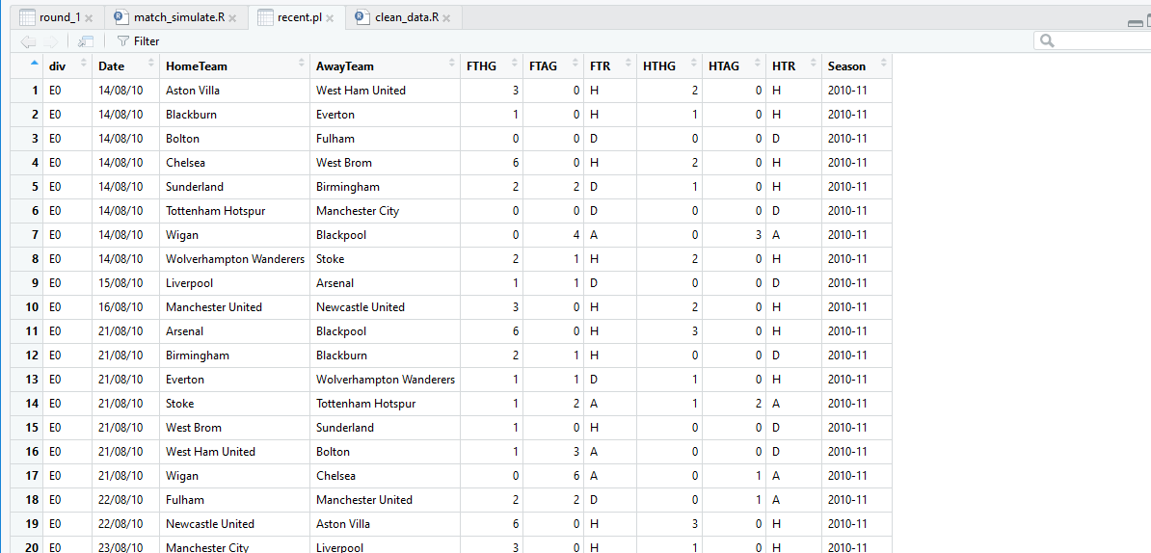
TRAINING SET

Slide 11
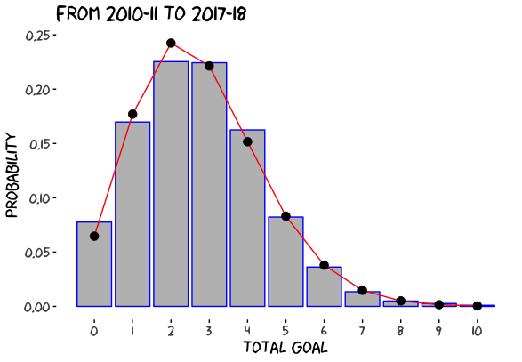
Total goals production

Slide 12
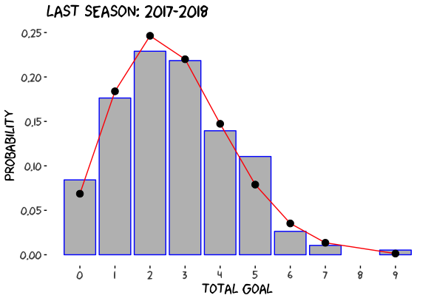
Goals production

Slide 13
Model Sets Used
In machine learning –extreme boosting
Data Mining: linear regression analysis.

Slide 14
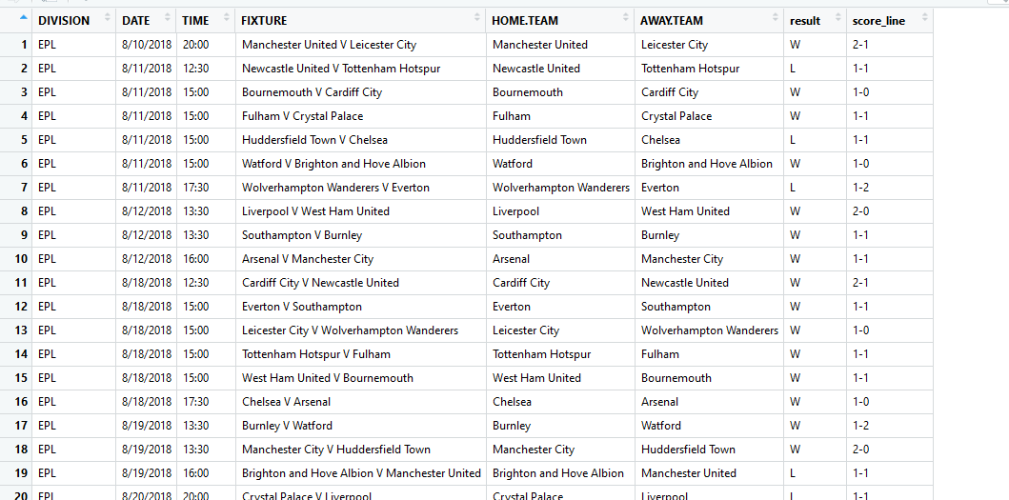
Result

Slide 15
CONCLUSION

Slide 16
References
Garcia, A. (2018). Premier League revenues hit record high $6.4 billion. CNN Business. Retrieved April 19, 2018, from https://money.cnn.com/2018/04/19/news/companies/premier-league-record-revenue/index.html.
Barnard, M., Dwyer, M., Wilsom, J., & Winn, C. (2018). Annual Review of Football Finance 2018 (pp. 1-36, Rep.) (D. Jones, T. Bridge, & M. Green, Eds.). Manchester, UK: Deloitte.

Slide 17
Thank you for your attention! Any questions?

